Slide 1
SumDoc
Clear and Concise

Slide 2
Implications
Healthcare is a field where no issue is too small and every solution helps
Patients that have issues remembering where things are at home will likely struggle with medical instructions
Individuals who suffer with remembering minute details will likely suffer with long texts with important info
SumDoc helps summarize and shorten the amount of text that individuals need to read and process

Slide 3
Applications
Shortens time going through complicated medical documents
Helps elderly people who have difficulty grasping complicated instructions
Promotes safety through breaking down post-operation instructions concisely
Helps reduce the intimidation of reading and facing medical issues, which can help speed up recovery

Slide 4
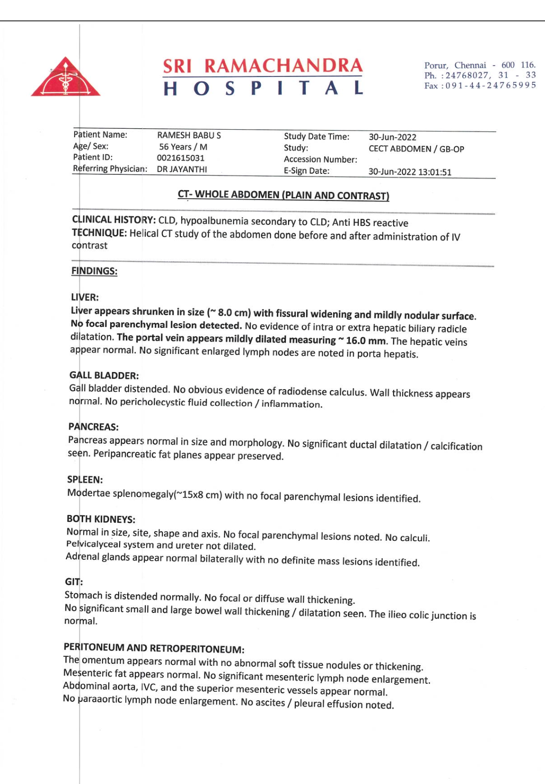
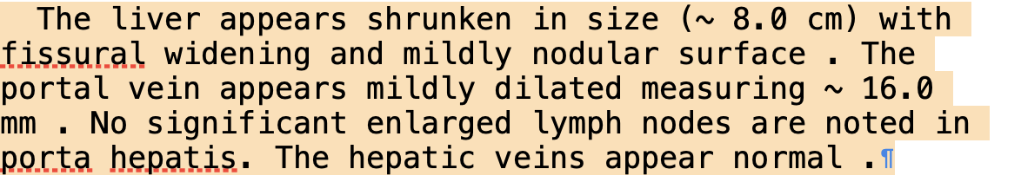
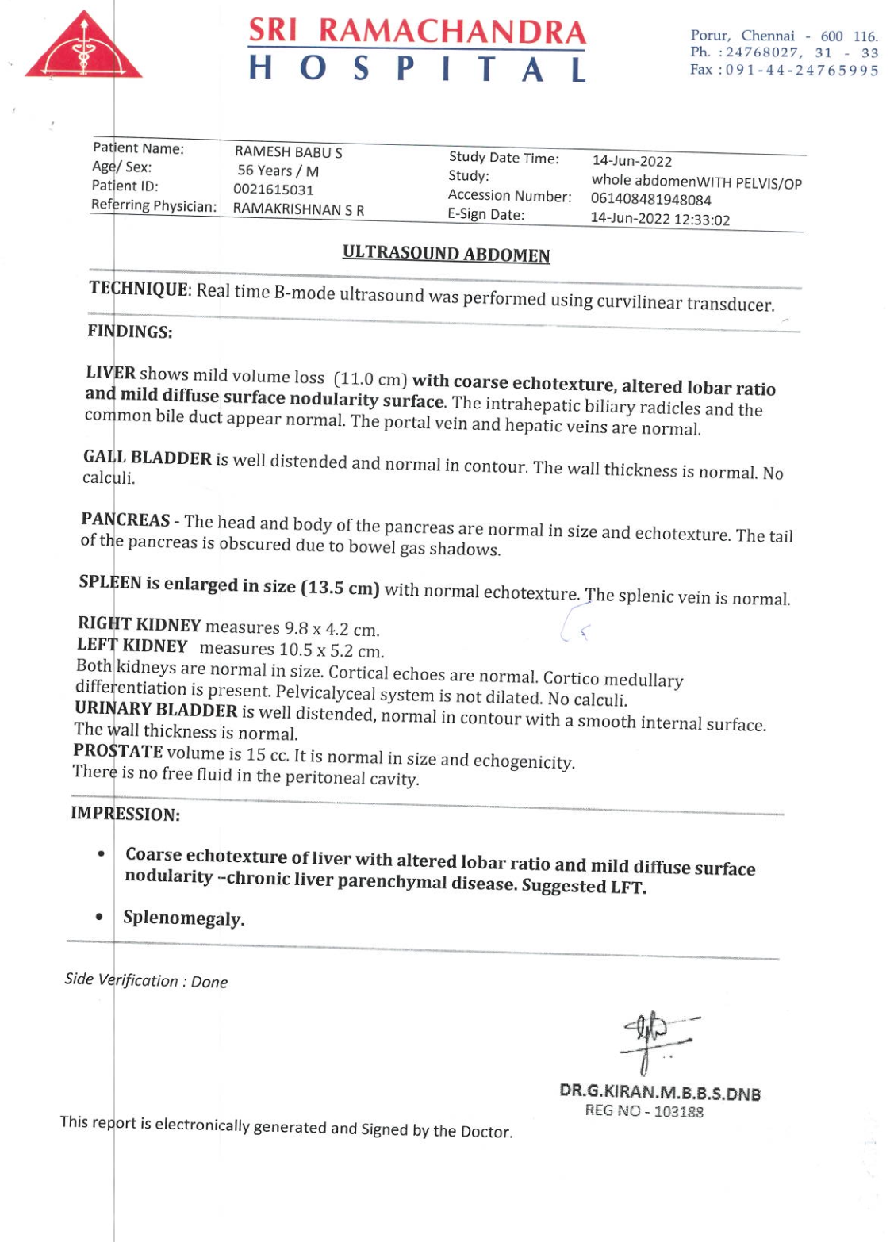
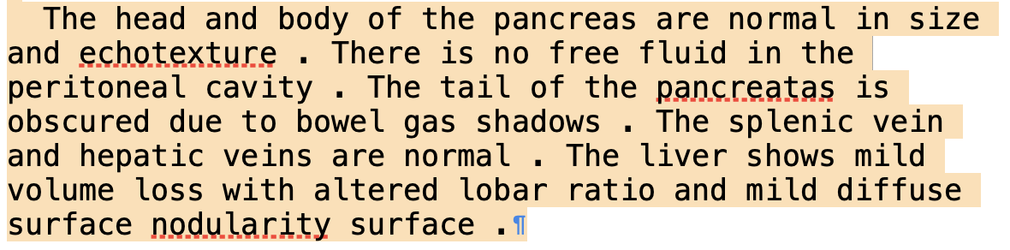

Slide 5
Potential Improvements
Could implement audio file-to-text feature
Could implement summarization of entire doc/pdf instead of page-by-page
Could implement pattern recognition to realize when certain pages don't need summarizing(Titles, Addresses, Namecards)
Could train our model using more medical data to increase its accuracy
Could use more handwritten data to improve accuracy

Slide 6
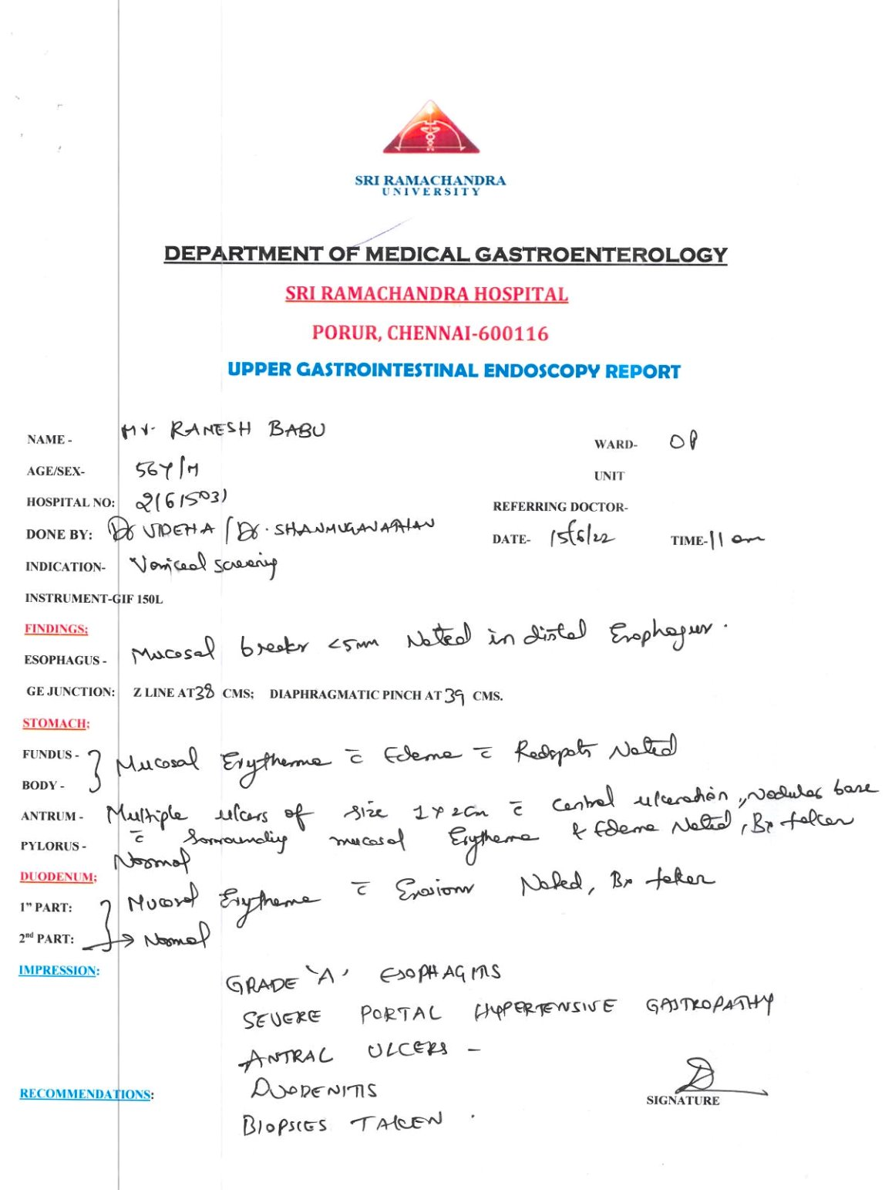
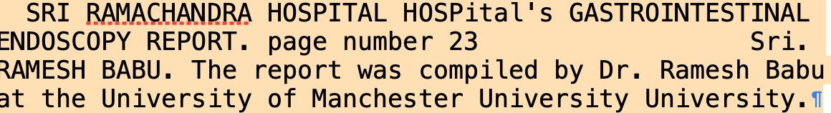
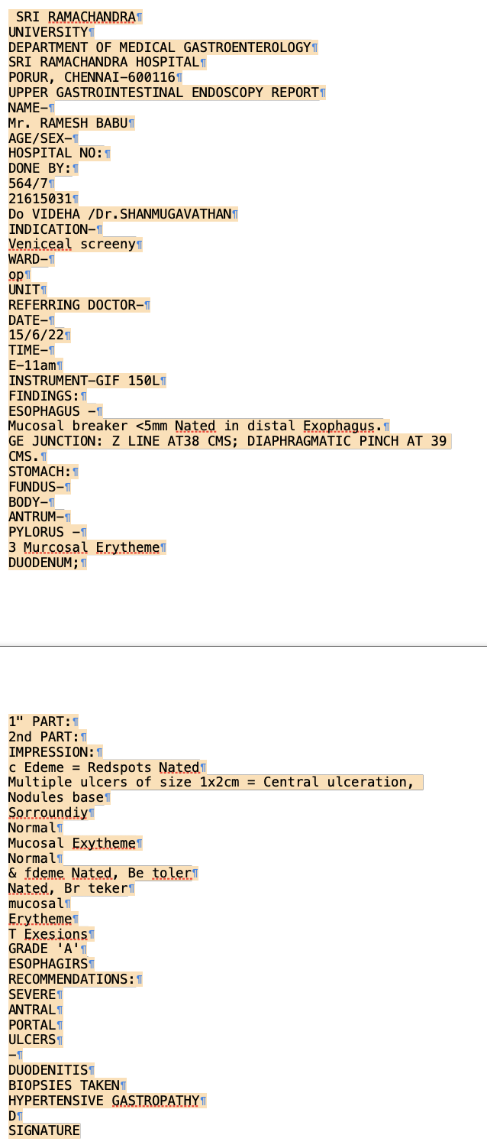

Slide 7
Thank you!
Demo

